Slide 1
Nighttime Backing Hazards
John Harvey, CHST
Brox Industries, Inc.

Slide 2
Nighttime Work Zones
Advantages to working at night
Less traffic at night
Lower impact on area businesses
Late at night we are often allowed to take more than one lane
New technology
Backup cameras standard equipment
Proximity systems available – each employee on the site is tracked

Slide 3
Challenges
Disadvantages/new hazards
#1 factor still remains: we cannot control the motoring public
Biological clocks – hazards and effects of shift work
Traffic typically travels at a higher speed – we can’t always get the speed limit reduced either
Reduced visibility
Higher likelihood of impaired and/or fatigued drivers
Weather – often worse at night and further impacts visibility
Noise and dust

Slide 4
Equipment in the work zone
Limited operator visibility
Operators focused on their tasks
Changing direction frequently
Very limited space between equipment and open traffic lane
Backup alarms – “habituation”

Slide 5
What does this sign really mean?

Slide 6
Let’s not forget…
Distracted Driving!
Nowadays, this is a HUGE hazard!

Slide 11
NIOSH Safety and Health Topic:
Highway Work Zone Safety
Construction Equipment
Visibility

Slide 12
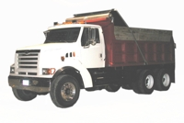
Ford LT9511

Slide 13
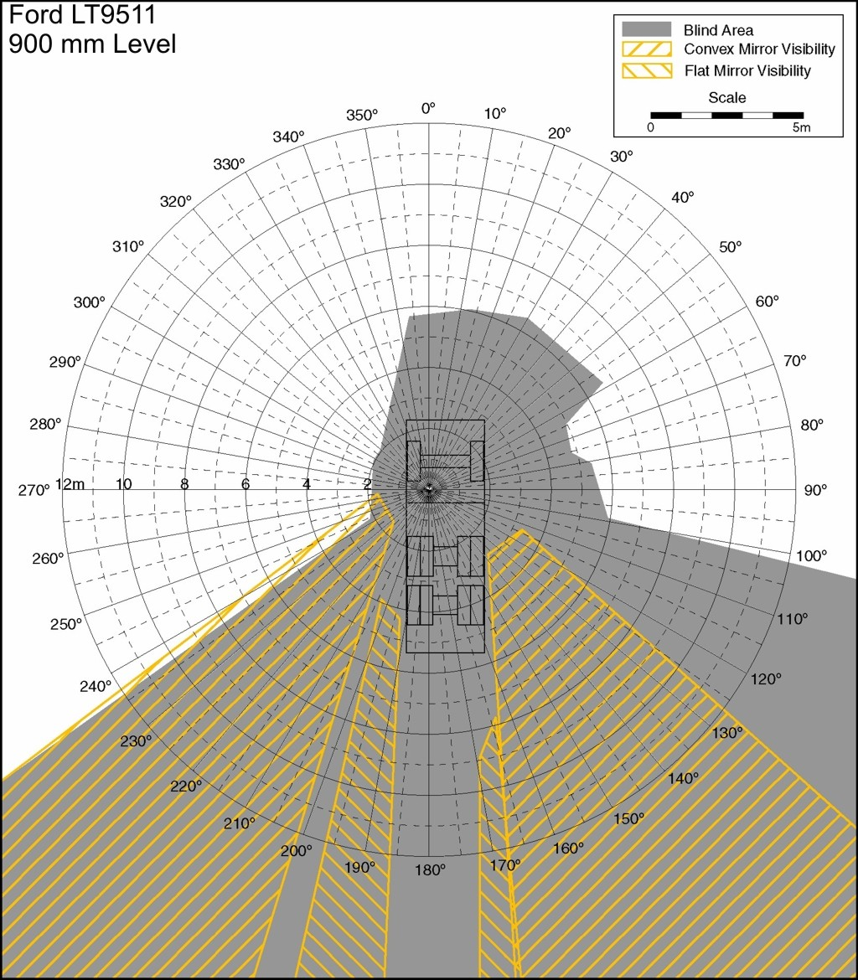
Ford LT9511

Slide 14
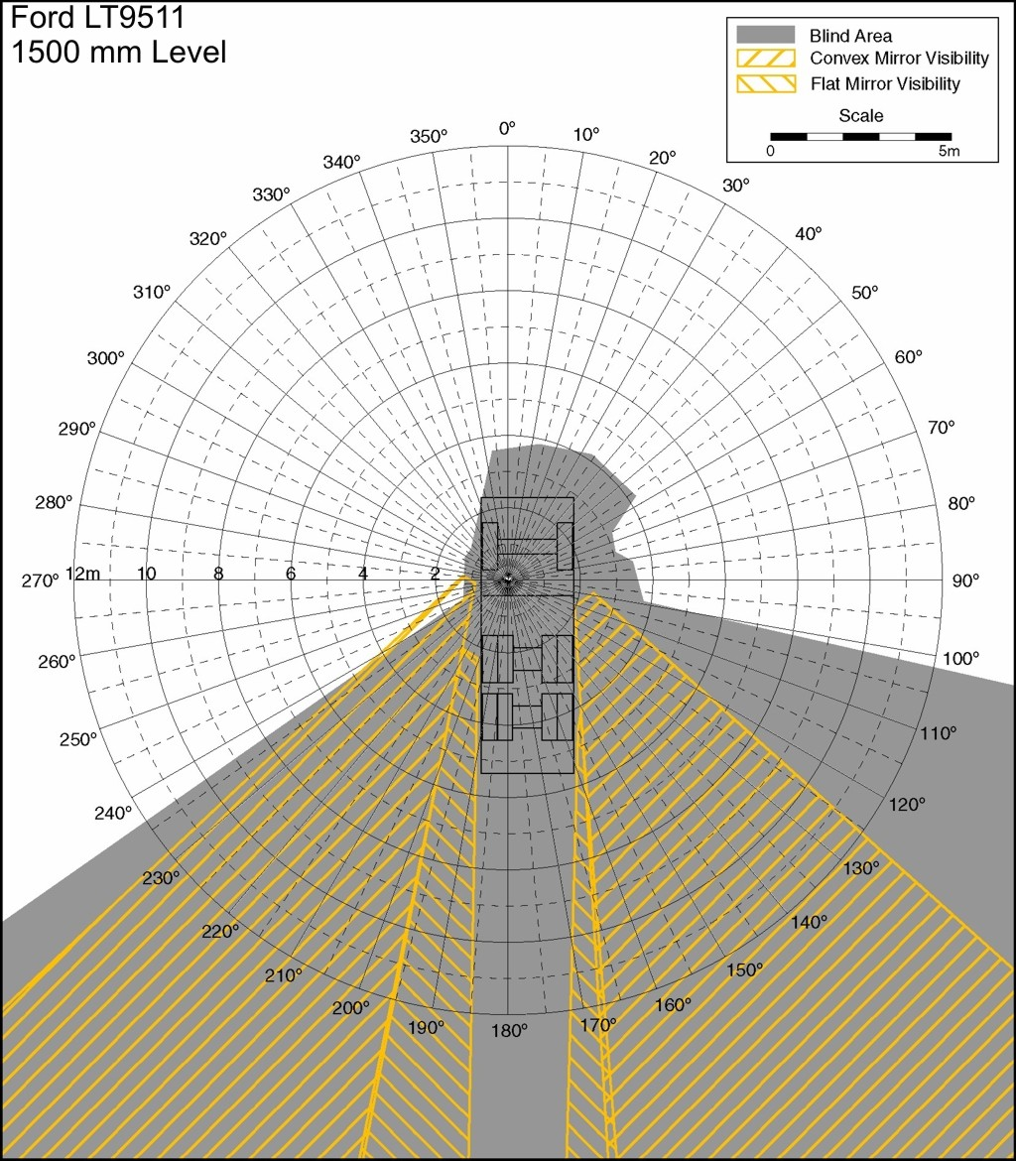
Ford LT9511

Slide 15
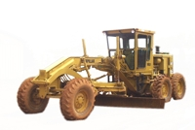
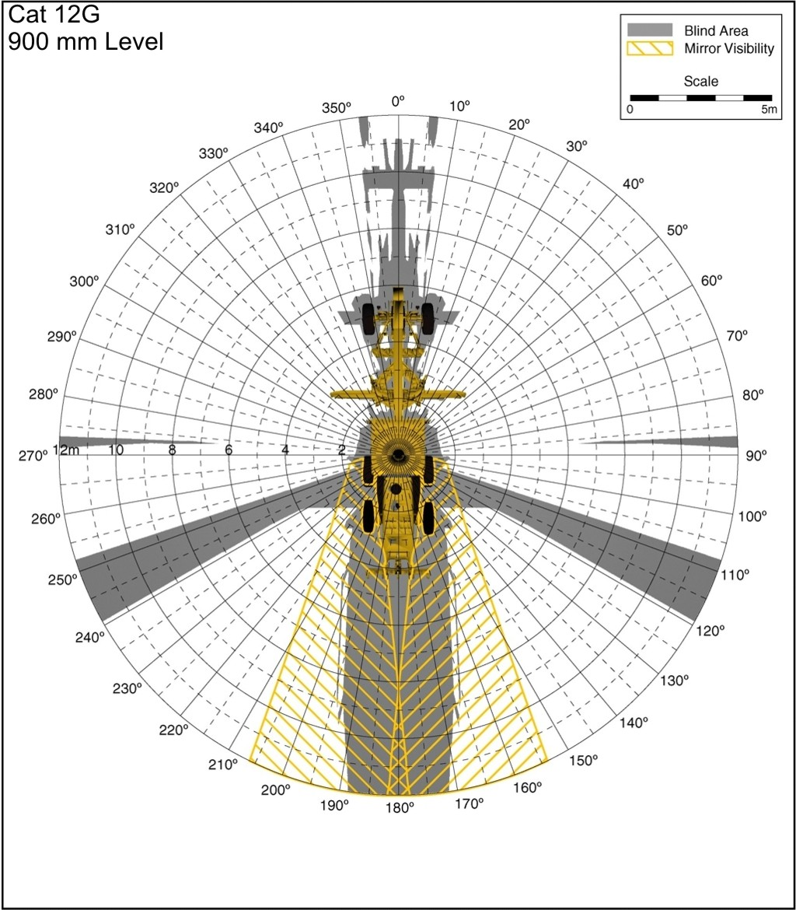
Cat 12-G Grader

Slide 16
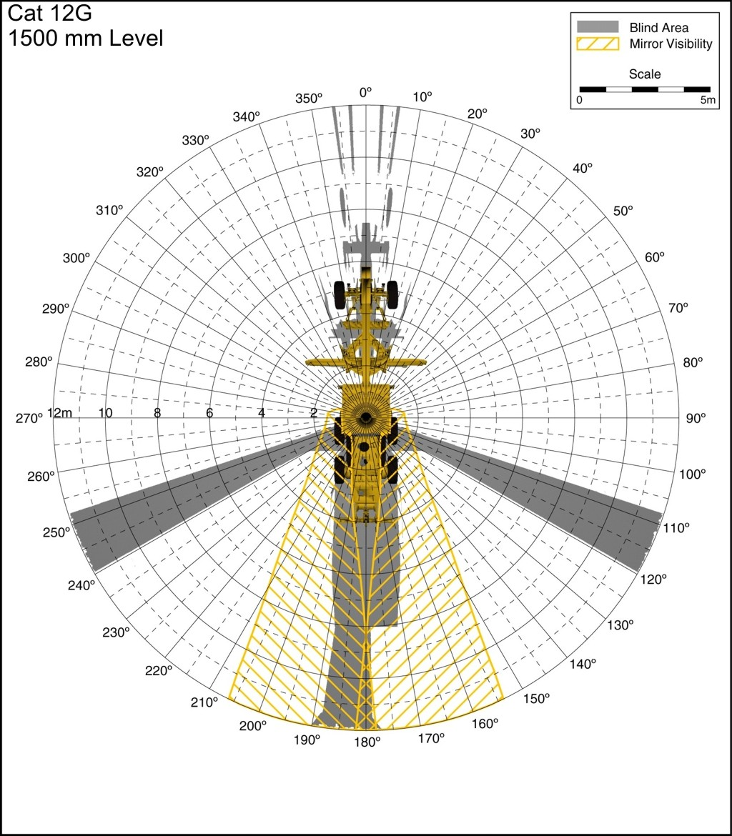
Cat 12-G Grader

Slide 17
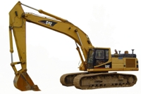
325-B Excavator

Slide 18
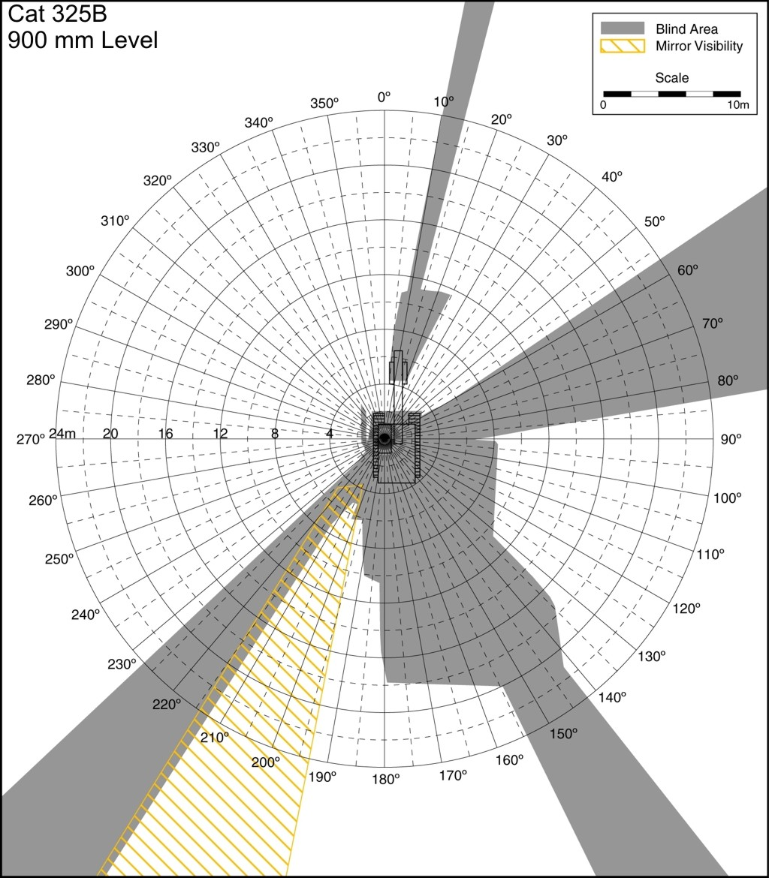
325-B Excavator

Slide 19
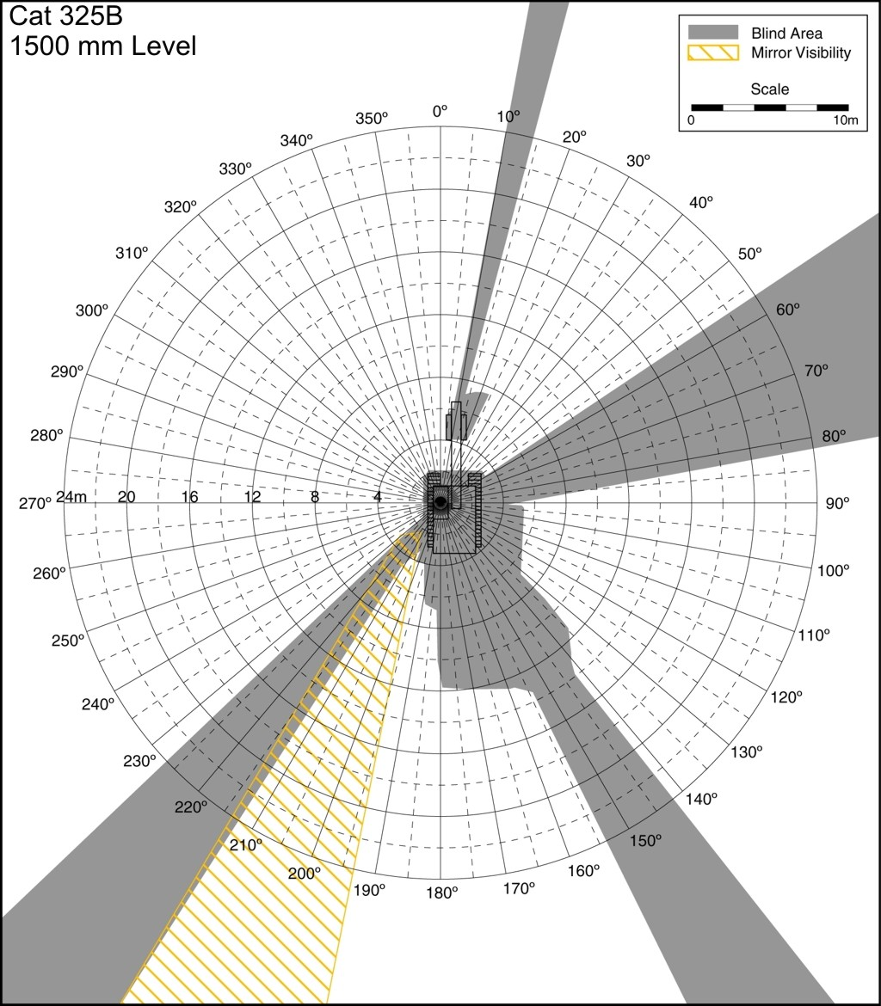
325-B Excavator

Slide 20
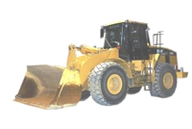
966-G Loader

Slide 21
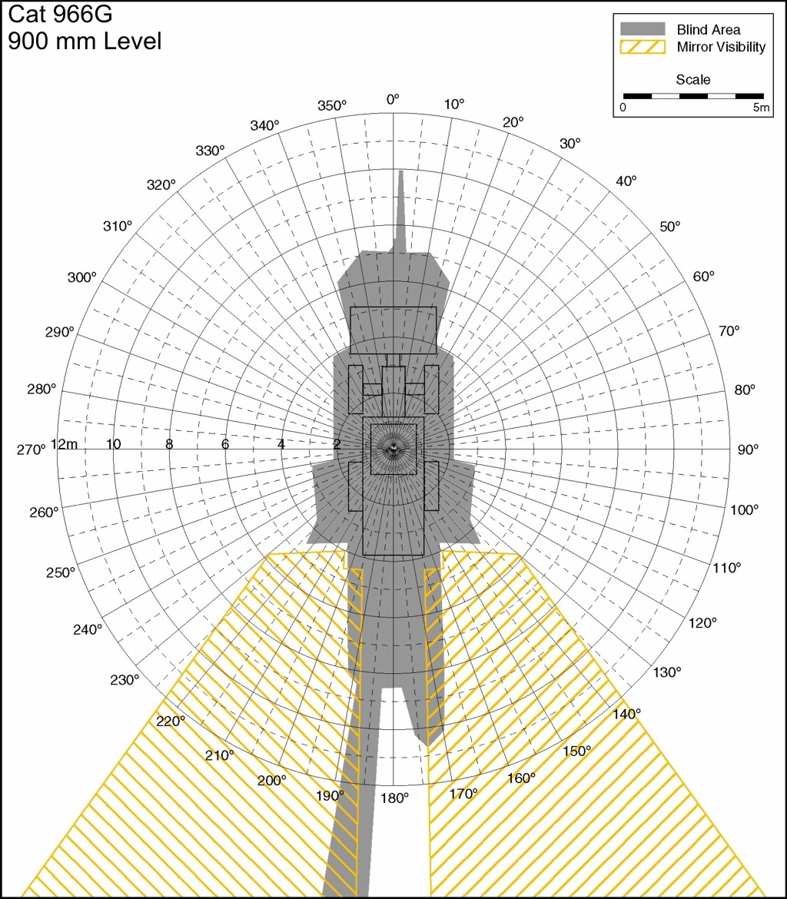
966-G Loader

Slide 22
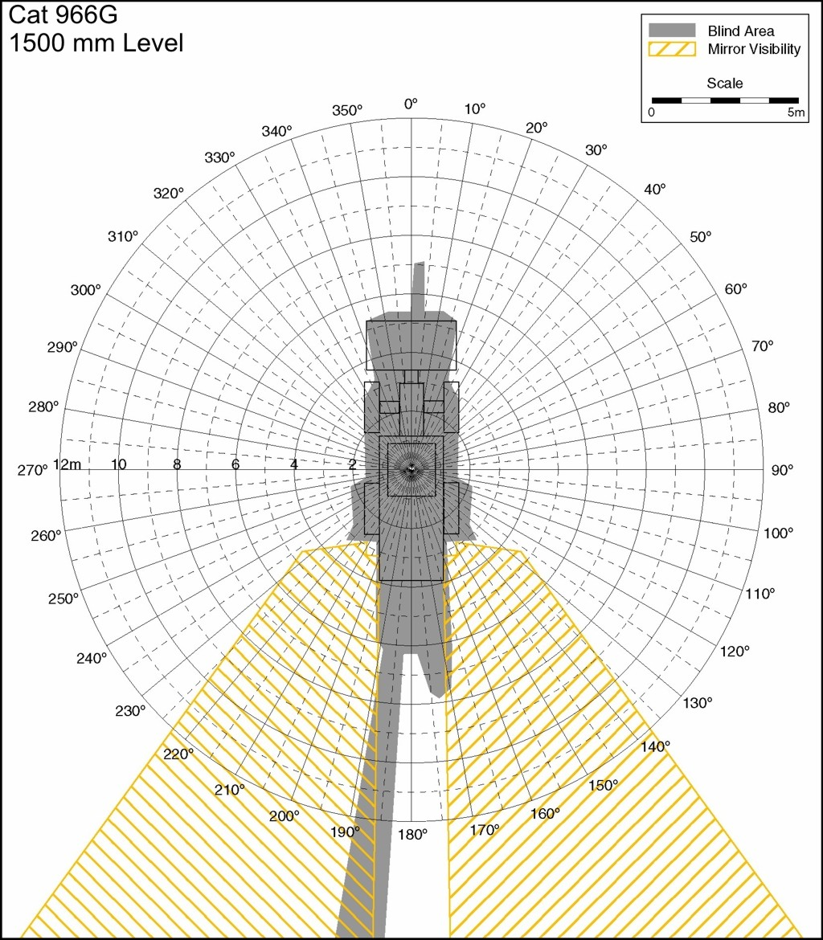
966-G Loader

Slide 23
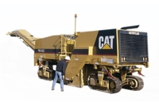
PM565 Cold Planer

Slide 24
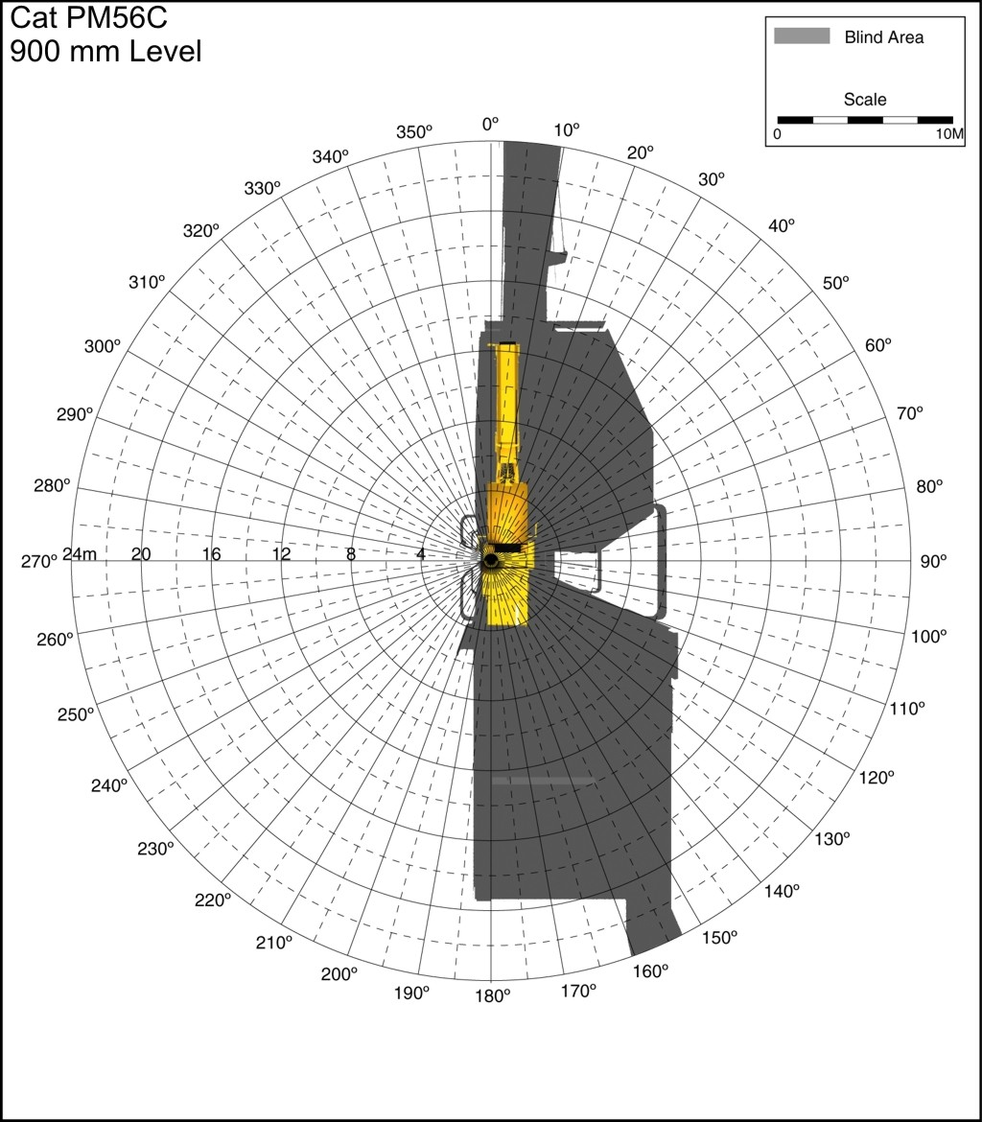
PM565 Cold Planer

Slide 25
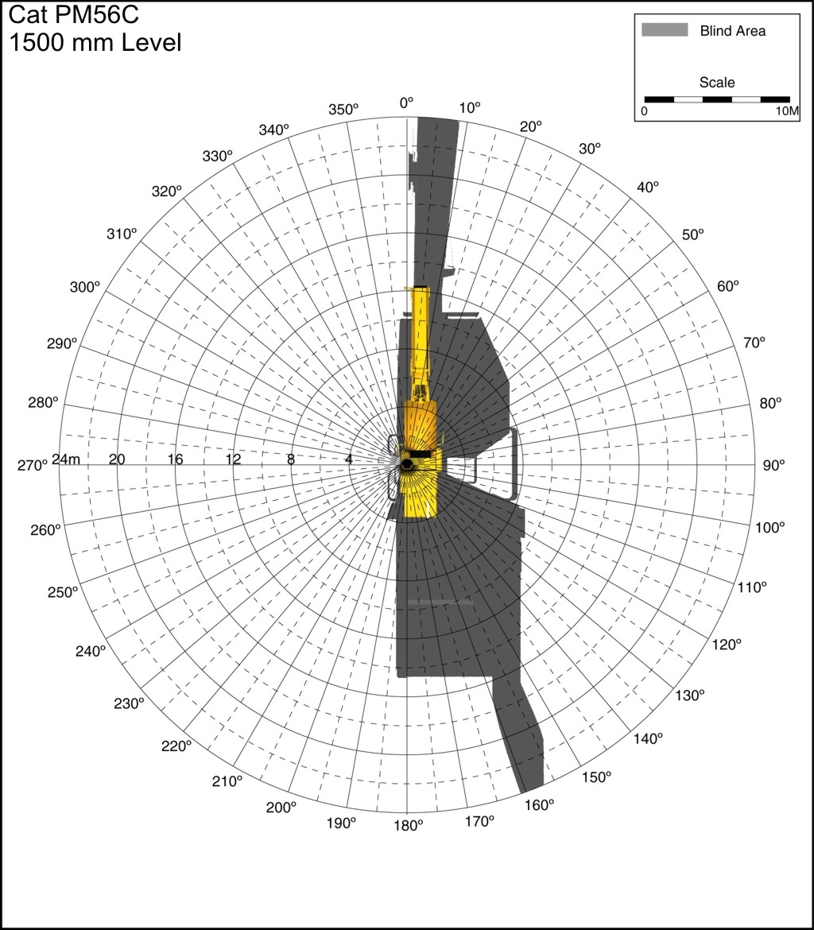
PM565 Cold Planer

Slide 26
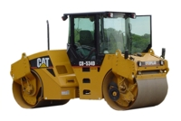
CB534D Roller

Slide 27
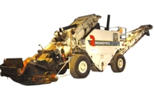
CB2500 Transfer

Slide 28
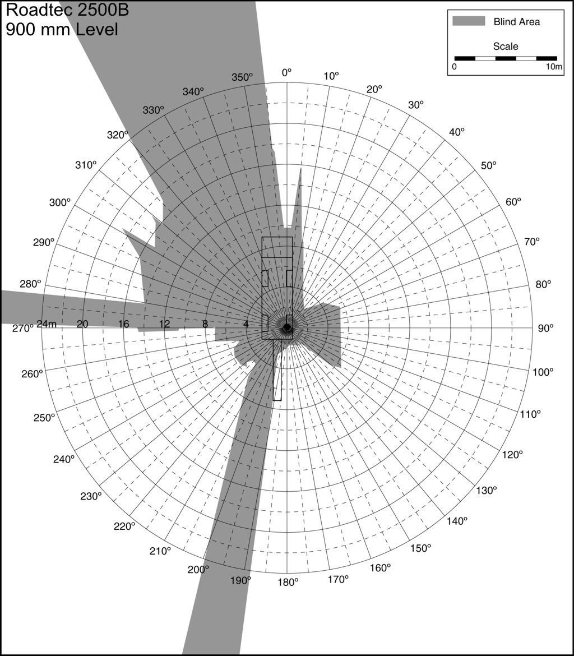
CB2500 Transfer

Slide 29
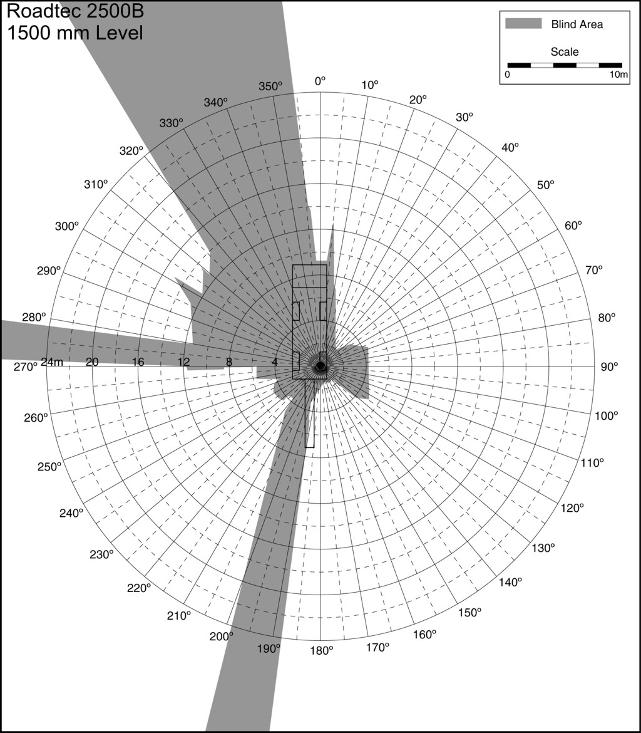
CB2500 Transfer

Slide 30
Work Zone Safety Hits Home
These incidents do happen…

Slide 32
Holyoke, MA I91 Work Zone Fatality June 2015
51 year old father of 2
Laborer struck and fatally injured by tri-axle dump truck during nighttime milling operation
Employee had family working on site with him at the time
Laborers were shoveling excess milled material into a skid steer bucket at the time of the incident
Employee was in middle travel lane up against the open low-speed lane
Employee was run over by the passenger side tandem axles as the dump truck was backing

Slide 33
What can go wrong…or right depending on POV

Slide 36
Operator’s point of view – paver and transfer machine

Slide 37
Some tools for prevention
Pre-shift safety meetings
Training
Dedicated safety crews with the sole function of setting up and maintaining work zones
Adequate lighting on site
PPE readily available
Comprehensive contract trucking agreements signed by all contractors
Driving and checking the work zone
Police details
Don’t just do the minimum – go above and beyond!
Make the TTCP work for its location and environment

Slide 38
Whistles for Life www.whistlesforlife.com

Slide 39
Whistles for Life
Distributed to all field employees, quarries/plants included
To be used for emergency purposes only
Workers can be very spread out – QC for example
Can be used to communicate the following
Employee in the “danger zone” of backing or moving equipment
Injury on site
Vehicle entering the work zone from the open travel lanes

Slide 40
Truck Spotters
New Brox policy for 2015 season
Designated truck spotters on each crew wears special orange vests to designate as the spotter and ticket taker
1 person from the crew designated by foreman
Policy communicated to all employees and also all hired trucks

Slide 41
References
Workzonesafety.org
Massachusetts FACE reports, mass.gov
CDC.gov, NIOSH Highway Work Zone Safety
Manual on Uniform Traffic Control Devices, 2009 edition

